Slide 1

Basic Controls I
Control Loops & Controller Hardware
Gina Becker
Presented to
MATC HVAC Students
10/7/19 & 10/10/19

Slide 2
Outline: What is a Control Loop
TOPICS
  Sensors
  Automated Devices
  Process
  Control Loop
  Control Strategies
  Controller Hardware

Slide 3
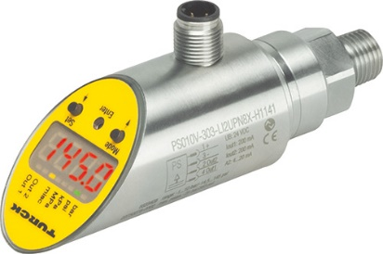
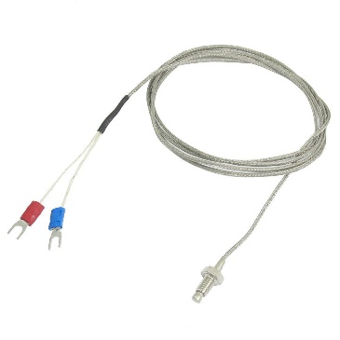
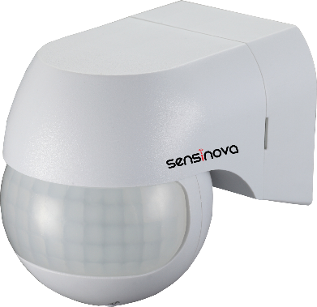
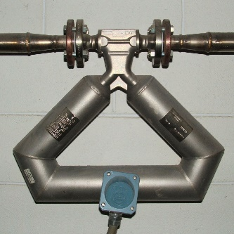
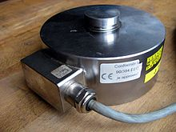
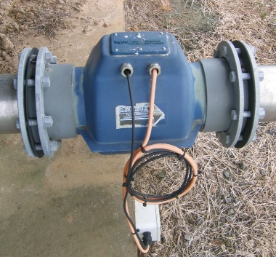
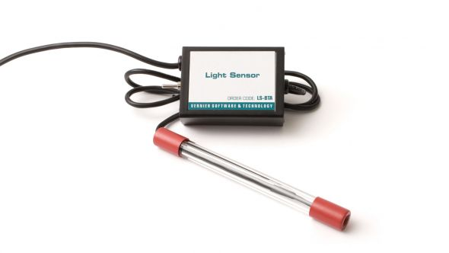
Overview of Controllers
SENSORS
Sensor: A device that detects & measures a physical property:
Sensor | Physical Property
Thermistor/ Thermocouple | Temperature
Pressure Sensor | Pressure
Motion Sensor | Movement
Flow Meter | Flow Rate
Scale | Weight
Light Detector | Light Level
This Photo by Unknown Author is licensed under CC BY-SA
This Photo by Unknown Author is licensed under CC BY-SA
This Photo by Unknown Author is licensed under CC BY-SA
This Photo by Unknown Author is licensed under CC BY-SA
This Photo by Unknown Author is licensed under CC BY-SA
This Photo by Unknown Author is licensed under CC BY-SA
This Photo by Unknown Author is licensed under CC BY-SA
Notes:
Pressure sensors include pressure transducers, transmitters, and switches.

Slide 4
CONTROLS RESEARCH ACTIVITY 01: TEMPERATURE SENSORS
Complete the Controls Research Activity 01
Useful References:
  Controls Research Activity_01Temp Sensors.docx
  Internet searches on temperature sensors
  Temperature Sensor Output tables
    https://www.bapihvac.com/sensor-specs/

Slide 5
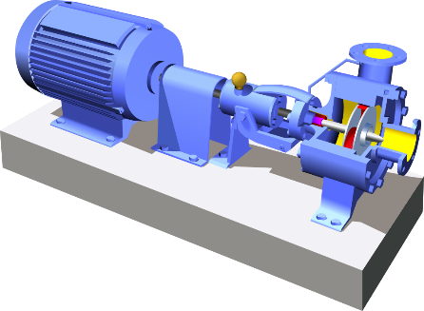
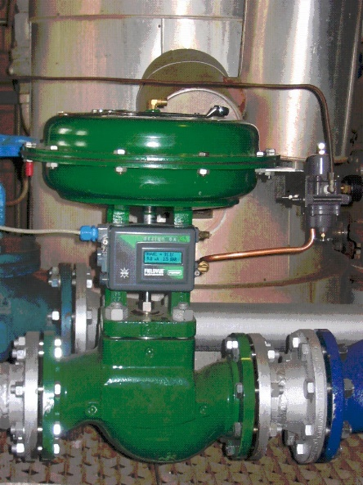
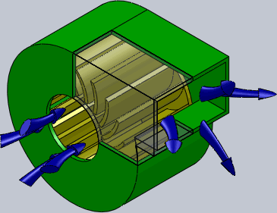
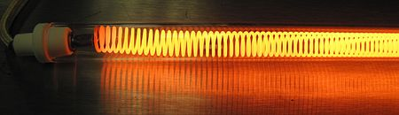
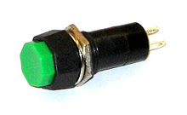
What is an automated device?
Automated device: A device that is adjusted by computer-controlled mechanisms
Automated Device | Adjusted to Change…
Control Valve | Flow Rate/ Pressure/ Temperature
Pump | Flow Rate/ Pressure
Blower | Flow Rate/ Air Speed/ Pressure
Heating element | Temperature
Switch | On/ Off
This Photo by Unknown Author is licensed under CC BY-SA
This Photo by Unknown Author is licensed under CC BY-SA
NOTE: Devices often require an actuator (motor, relay, piston) to convert an electrical or pneumatic signal into motion.
This Photo by Unknown Author is licensed under CC BY-SA
This Photo by Unknown Author is licensed under CC BY-SA
This Photo by Unknown Author is licensed under CC BY-SA
This Photo by Unknown Author is licensed under CC BY-SA-NC
Notes:
This Photo is licensed under CC BY-SA (Photos in presentation were inserted through ppt feature. Free licenses. No author given for attribution.

Slide 6
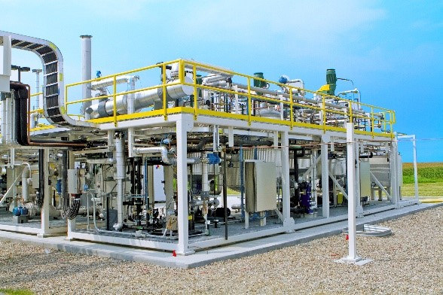
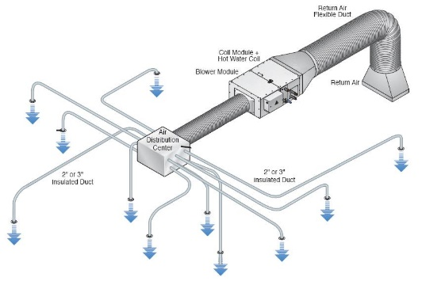
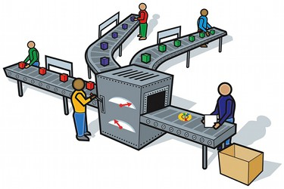
What is an Automated Process?
Automated Process: A series of automated procedures, including chemical, physical, electrical or mechanical steps, to achieve a desired end.
Automated Process | Desired End
Toy Ball Production | Discrete manufacturing of toy balls
Chemical Production | Continuous production of chemicals
HVAC System | Continuous control of environmental conditions
Packaging | Packaging of manufactured items
This Photo by Unknown Author is licensed under CC BY-SA
This Photo by Unknown Author is licensed under CC BY-SA
This Photo by Unknown Author is licensed under CC BY-SA

Slide 7
Process Variables
Process Variable: Measured / monitored physical properties of a process
Air-Loop Process Variable | Units
Return Air Temperature | F
Make-up Air Temperature | F
Mixed Air Temperature | %
Return Air Flow Rate | SCFM
Make-up Air Flow Rate | SCFM
Supply Air Flow Rate | SCFM
Blower Speed | RPM
Damper Opening | %
Pressure Drop Across Filter | psi
Damper 1 Position | %
Water-Loop Process Variables | Units
Inlet Water Temperature | F
Outlet Water Temperature | F
Water Flow Rate | GPM
Valve Position | %
Return Air
Filter
Heat Exchanger
Blower
Supply Air
(to bldg rooms)
Mixed Air

Slide 8
Controllers & Control Loops
Controller: A computer that directs equipment in a process.
  Gathers data from sensors (“Input”)
  Makes decisions/ calculations based on data & programming
  Sends instructions to devices or actuators (“Output”)
INPUT
Controller
OUTPUT
Measurement
Control Loop
Adjustment
Process

Slide 9
Electrical Signals in a Control Loop
CONTROLLED PROCESS
Error = (Setpoint – Sensor Reading)
SENSOR:
Motion detector
Level sensor
Light detector
Pressure sensor
Temperature sensor
Flow meter
Controller
User Interface:
Computer
Input screen
Setpoint
Measurement
Input Signal
Input Signal
(sensor reading)
Adjustment
Output Signal
CONTROLLED DEVICE:
Pump
Dimmer
Valve
Lamp
Lock
Feedback
Input Signal
(current status or position)
Notes:
Basic flow path of air. Role of heat exchangers and how they work. Role of filter. Ventilation. Role of dampers in air conditioning and ventilation. Mention humidification and fans.

Slide 10
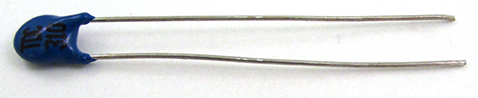
Overview of Controllers
SENSORS
Active Sensor: Requires an external power source
Example: Thermistor
Must pass current through it
      A resistor used to measure temperature
      Resistance changes with temperature
        Hotter = lower resistance
        Cooler = higher resistance
        Known correlation
      Electrical effect converted and scaled to a signal that a controller can read:
        4 - 20 ma
        0 – 5 V
Involves:
Transducer: Converts a signal of one form into another (e.g. Temperature ←→ Electrical).
Transmitter: Transmits electromagnetic waves that carry a signal (data).
Notes:
Pressure sensors include pressure transducers, transmitters, and switches.

Slide 11


Overview of Controllers
SENSORS
Passive Sensor: Generates its own current
Example: Thermocouple
Generates its own current
      Two different conductive metal wires
      Joined at one end
      Produces a temperature-dependent voltage
      Electrical effect converted, conditioned, and scaled to a signal that a controller can read:
        4 - 20 ma
        0 – 5 V
This Photo by Unknown Author is licensed under CC BY-SA
Involves:
Transducer: Converts a signal of one form into another (e.g. Temperature ←→ Electrical).
Transmitter: Transmits electromagnetic waves that carry a signal (data).
This Photo by Unknown Author is licensed under CC BY-SA
This Photo by Unknown Author is licensed under CC BY-SA
Notes:
Pressure sensors include pressure transducers, transmitters, and switches.

Slide 12
What is an actuator?
Actuator: A device that converts energy (e.g. electrical or pneumatic) into motion:
  Motor Receives electrical signal Changes position of a valve
  Piston Receives pneumatic signal Changes position of a valve

Slide 13
CONTROLS RESEARCH ACTIVITY 02: ACTUATORS
Complete the Controls Research Activity 02
Useful References:
  Controls Research Activity_02 Actuators.docx
  Internet searches on temperature sensors

Slide 14

Can you identify the control loop components?
This Photo by Unknown Author is licensed under CC BY-SA
Setpoint Temperature = 110F
PLC
thermocouple
Sensor reading = 80F
Stirrer
Hot Plate
Notes:
What is happening in this process? What is the sensor? What is a setpoint? What is the controlled device? What is the controller? What is the error? What type of signals (input/output)? What signal is the PLC sending to the hot plate? What types of calculations might be required?

Slide 15
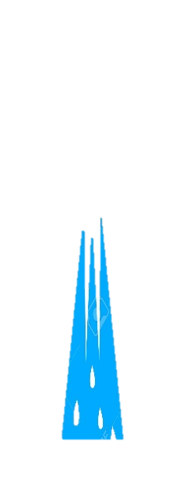
Can you identify the control loop components?
level sensor
PLC
motor
valve

Slide 16
Can you suggest control loops & components?
Exhaust Air
(to outside)
Return Air
(from bldg. rooms)
Dampers
This Photo by Unknown Author is licensed under CC BY-SA
Filter
Heat Exchanger
Outdoor Air
(from outside)
Blower
Supply Air
(to bldg rooms)
Mixed Air
Notes:
What is happening in this process? What types of sensors would there be? What types of controlled devices? What types of setpoints? What types of calculations by the controller?

Slide 17
Controller Hardware
TOPICS
  Types of Controllers
  Controller Connections
  Signals & Controller
  Wiring a controller

Slide 18
Types of Controllers
  PLC = Programmable Logic Controllers
  Application
  Supervisory
  Building Automation System
  Industrial

Slide 19
Controller Connections
INPUTS:
Universal Inputs (UI)
  Analog: 0-10VDC, 0-20 mA
  Thermistors: Type II or Type III
  Resistance: 1 k Ω to 100 kΩ
  Contact closure
  Pulse input accumulators
Binary Inputs (BI)
  Contact closure
OUTPUTS:
Analog Outputs (AO)
  0-10V
Binary Outputs (BO)
  Normally Open (NO) switches
  Supply external power
  Low voltage only (24V)

Slide 20
Controller Connections
Power Input: 24 VAC

Slide 21
Controller Connections
Cat5e Ethernet Cable
Optional internet connection
Talk to other controllers

Slide 22
Thermistor Connection

Slide 23
Controller Wiring Activity
Research each part via internet searches for product specifications and instructions
  Thermistor
  Push Button
  Panel Indicator LED Lamp
Wire each part to the controller (power off)
Test the wiring via the programming software
Write programming to control the lamp via the push button

Slide 24
Truth Tables

Slide 25
Take Control of the AC
Replace the Thermostat with the Controller
Develop a wiring diagram
Write a sequence of operations (Light, CFM, EFM)
Wire the Light, CFM, EFM to the controller
Write a program to control the temperature

Slide 26
Download Sedona Software
Can Sedona be downloaded onto anyone’s tablet?
https://www.ccontrols.com/basautomation/bastools.php

